Slide 1

NET-ZERO 2030 ROADMAP
(MANUFACTURER)
A practical path to decarbonize a mid-size manufacturer by 2030: 90 ktCO2e abatement, 60 ktCO2e neutralized residuals, resilient economics, and clear execution.

Slide 2
Agenda
Baseline and Target
Abatement Levers + MAC Curve
Energy Procurement (PPAs / On-site)
Process Electrification
Economics: Capex, Opex, Payback
Incentives by Region
Risks and Mitigations
Governance and KPI Dashboard
6-Quarter Execution Plan
Call to Action

Slide 3
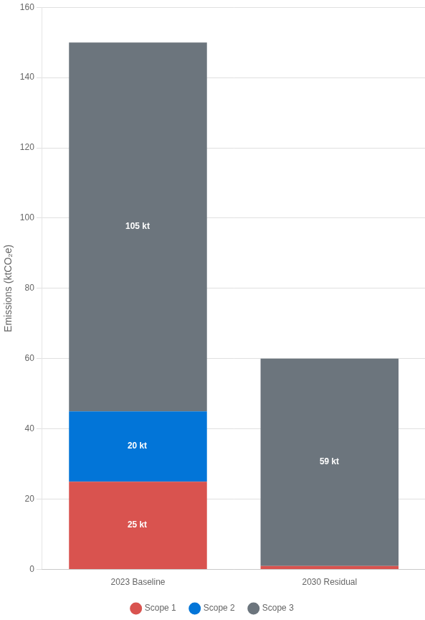
Baseline Emissions and 2030 Target
Baseline Year: 2023
Scope 1:
25 ktCO₂e
Scope 2 (location-based):
20 ktCO₂e
Scope 3:
105 ktCO₂e
Total:
150 ktCO₂e
Target 2030 (Post-Abatement)
Scope 1:
1 ktCO₂e
Scope 2 (market-based):
0 ktCO₂e
Scope 3:
59 ktCO₂e
Total:
60 ktCO₂e
Neutralization Plan: Neutralize residual 60 ktCO₂e in 2030 with high-durability removals (mineralization/BECCS) via phased offtake contracts starting 2026.
Scope 2 shown location-based for baseline; market-based will reach ~0 kt by 2027 with 100% renewable electricity.
Neutralized withhigh-durability removals:60 ktCO₂e
Neutralized withhigh-durability removals:60 ktCO₂e

Slide 4
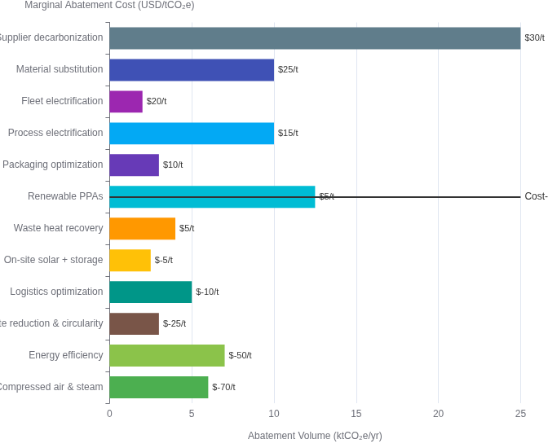
Abatement Levers and MAC Curve
Twelve prioritized levers deliver 90 ktCO2e/yr abatement by 2030.
62% of abatement volume is cost-saving or near-zero cost, creating immediate economic benefits while reducing emissions.
Levers by scope:
Scope 1: Compressed air optimization, Waste heat recovery, Fleet electrification
Scope 2: Renewable PPAs, On-site solar + storage
Scope 1+2: Process electrification, Energy efficiency
Scope 3: Supplier decarbonization, Material substitution, Logistics optimization, Waste reduction, Packaging

Slide 5
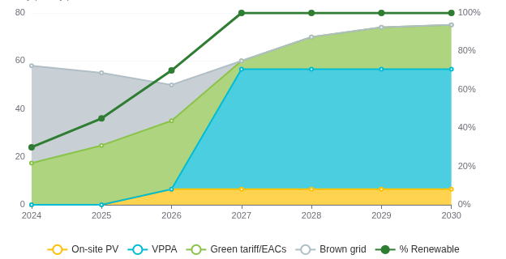

100% Renewable Electricity: PPAs + On-site
Electricity Demand (GWh/yr)
2024: 58 | 2025: 55 | 2026: 50 | 2027: 60 | 2028: 70 | 2029: 74 | 2030: 75
Procurement Portfolio
On-site PV: 5 MWdc rooftop/ground-mount, ~6.5 GWh/yr from 2026; 2 MWh/1 MW battery for peak shaving
VPPA: 50 GWh/yr solar/wind VPPA from 2027; tenor 10 years; hub-settled, baseload-shaped
Green Tariff/EACs: Top-up to 100% from 2027 (3.5-18.5 GWh/yr); 30-70% prior to VPPA start
Brown Grid: Decreasing from 70% to 0% by 2027
Achievement: 100% renewable electricity by 2027 through strategic mix of on-site generation, virtual PPAs, and EACs

Slide 6

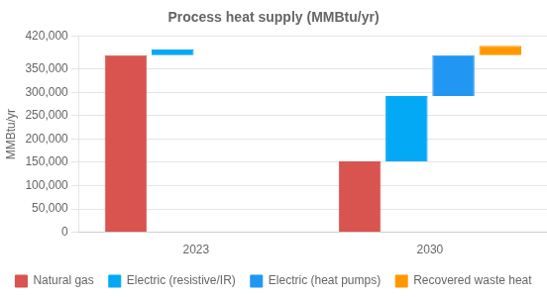
Process Electrification Roadmap
Baseline process heat: 400,000 MMBtu2030 target: Electrify 60% of low/medium-temp heat; pilot one high-temp line; integrate 20k MMBtu/yr recovered waste heat
Key Benefits
60% reduction in natural gas consumption by 2030
10 ktCO2e annual abatement by 2030
Thermal storage enables load shifting for demand charge reduction
Equipment Plan
4 × 3 MW electric boilers (steam/hot water)
Waste heat recovery improves overall system efficiency by 15%
6 × 1.2 MW industrial heat pumps (COP 2.5-3.0)
3 × electric IR/convective ovens (1.5-2 MW each)
Thermal storage (4 MWhth) for load shifting
Phasing
2024-2025:
FEED studies, pilots, utility interconnection
2026-2027:
Phase 1 (2 boilers, 3 heat pumps)
2028-2030:
Phase 2 (remaining units, IR ovens, waste heat)

Slide 7
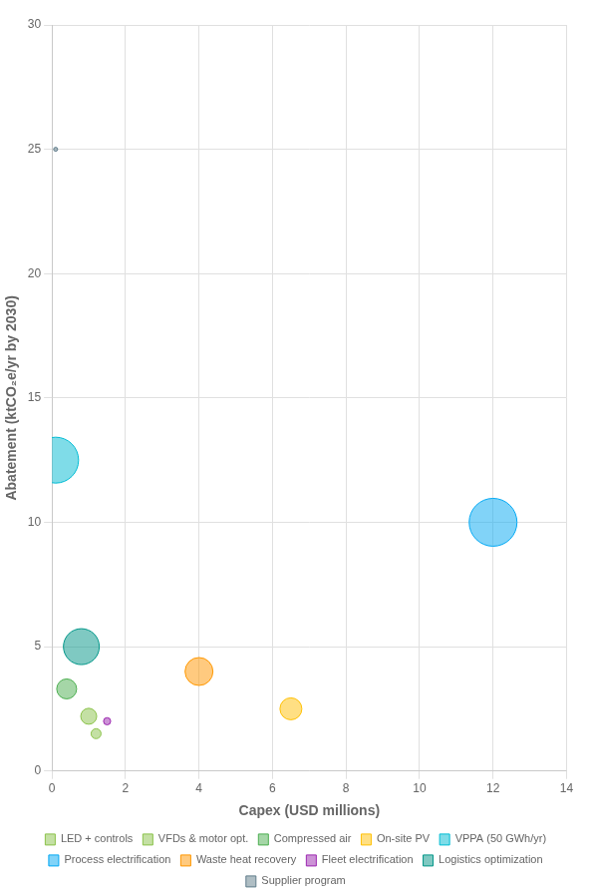
Initiative Economics: Capex vs. Abatement
Economics: Capex, Opex, Payback
Key Assumptions:
WACC
8%
Carbon shadow price
$75/t
Power price
$55/MWh
Escalation
2% per year
Gas price
$6/MMBtu
Key Initiatives:
Capex ($M)
Annual Savings ($M)
Abatement (ktCO2e)
Simple Payback
Initiative
Compressed air program
0.4
0.5
3.3
0.8 years
Logistics optimization
0.8
0.9
5.0
0.9 years
VFDs & motor optimization
1.0
0.4
2.2
2.5 years
LED + controls
1.2
0.25
1.5
4.8 years
Waste heat recovery
4.0
0.7
4.0
5.7 years
VPPA (50 GWh/yr): $0 capex, $1.15M annual savings, 12.5 kt abatement
Process electrification: $12M capex, $1.2M annual savings, 10 kt abatement, 10y payback
Supplier program: $0 capex, ~$2M/yr opex, 25 kt abatement via engagement & audits
Bubble size represents annual savings (USD millions)

Slide 8
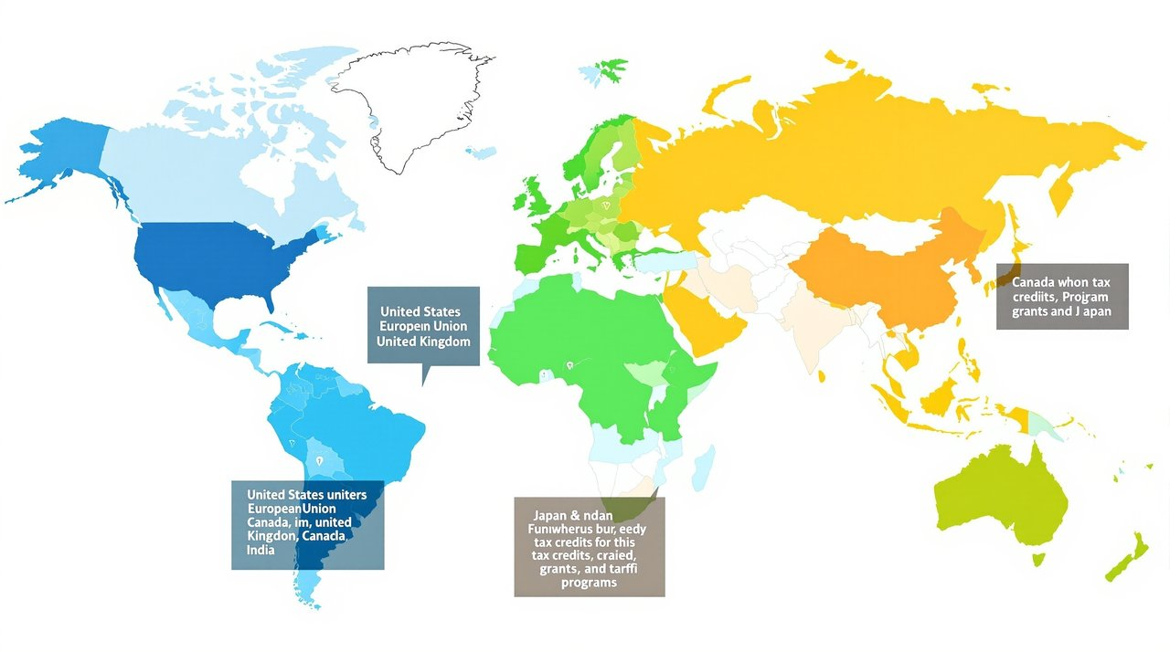
Incentives and Funding by Region
United States
European Union
IRA 48E Clean Electricity ITC: 30% ITC (up to 50% with energy community/domestic content adders)
EU Innovation Fund / CEF: Up to ~60% of CAPEX/OPEX for industrial decarb pilots
Best for large-scale electrification/waste heat
Applies to on-site solar + storage meeting prevailing wage/apprenticeship
REPowerEU / National schemes: 10-55% CAPEX grants (country-specific)
Industrial Decarbonization Grants (DOE): $5M-$500M competitive grants
E.g., Germany EEW, France ADEME
Focus on electrification, heat pumps, waste heat recovery
EU ETS / CBAM readiness: Avoided carbon costs; funding via ETS revenues
CBAM reporting now in transition; cost exposure from 2026
Section 179D: Up to $5.00/sq ft for efficiency
Owner vs. designer allocation rules apply
United Kingdom
Canada
Industrial Energy Transformation Fund (IETF): 30-65% CAPEX for efficiency and fuel-switch
Clean Technology ITC: 30% ITC for solar, wind, storage, heat pumps
Phase-down dates apply
Electrification and process heat eligible
SIF / NRCan Industrial: Grants/loans for industrial decarbonization
Full Expensing (Capital Allowances): 100% first-year deduction on main pool capex
Supports electrification and efficiency
Improves NPV on equipment
Japan
India
Green Growth Strategy subsidies: Up to ~50% for industrial electrification pilots
Accelerated Depreciation (RE): Up to 40% accelerated depreciation for RE assets
Coordinates with utility green tariffs
Varies by state DISCOM
PLI / Industrial efficiency schemes: Targeted incentives for manufacturing upgrades
Eligibility varies
Note: Confirm current eligibility, prevailing wage/domestic content, and state-aid rules prior to commitment.

Slide 9
Key Risks and Mitigations
Electrification performance shortfall
5
A
Capex overrun and schedule slip
PPA basis/price risk
C
B
4
Change management & operator adoption
Policy/EAC claim changes
Long-lead equipment delays
E
F
D
Impact (1-5)
3
2
1
1
2
3
4
5
Risk
Description
Likelihood/Impact
Likelihood (1-5)
Mitigation Strategy
A
Electrification performance shortfall (temperature, throughput)
Medium/High
Pilot on one line; include fallback gas trim; thermal storage; vendor performance guarantees
B
PPA basis/price risk and counterparty credit
Medium/Medium-High
Hub selection analysis; add basis hedge; multi-seller RFP; credit insurance
C
Capex overrun and schedule slip
Medium/High
EPC wrap; 15% contingency; stage-gate FEED; weekly PMO controls
D
Long-lead equipment delays (transformers, switchgear)
High/Medium
Early procurement (NTP Q4); multi-source vendors; temporary rentals
E
Policy/EAC claim changes (RECs quality, additionality)
Medium/Medium
Prioritize bundled VPPA; align with market-based reporting (GHG Protocol); annual assurance
F
Change management & operator adoption
Medium/Medium
Formal training, SOP updates, incentive plans; kaizen cycles

Slide 10
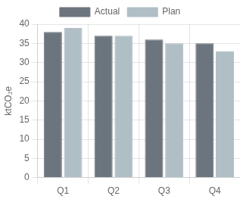

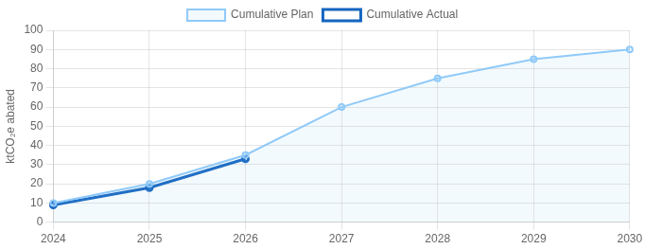
Governance and KPI Dashboard
Governance Model
Scopes 1-3 Emissions (quarterly)
% Renewable Electricity
Steering Committee: CEO (chair), CFO, COO, VP Sustainability, VP Supply Chain — meets monthly
Program Management Office: Head of Decarbonization + site PMs — weekly cadence
Workstreams:
• Efficiency
• Energy procurement
68
• Electrification
%
• Supplier/Scope 3
• Data & reporting
Current Status
Assurance: Annual third-party verification (limited to reasonable by 2028)
Key Performance Indicators
Abatement Burn-up (cumulative ktCO₂e)
Total emissions (ktCO₂e, Scopes 1-3)
150
120
0
Scopes 1+2 market-based (ktCO₂e)
45
25
0
Renewable electricity share (%)
22
45
100
Energy intensity (kWh per unit output)
12
10
8
Supplier coverage (% spend with SBTi targets)
15
40
80
Project schedule adherence (%)
-
90
95
Baseline
2025
2030

Slide 11
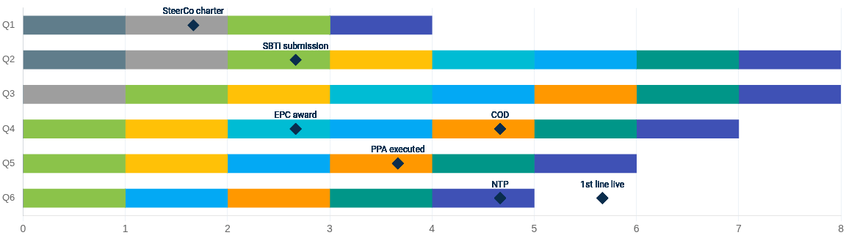
6-Quarter Execution Plan (Q1–Q6)
Time frame: Q1 2024 – Q2 2026
Program setup & governance
Data, baselining & SBTi target
Efficiency (waves 1-3)
On-site solar + storage
VPPA procurement
Process electrification
Waste heat recovery
Fleet & logistics
Supplier engagement
Key Milestone
Key Dependencies
Utility interconnection approvals precede electrification installs
VPPA execution precedes 100% RE target
Supplier code and data templates precede Scope 3 reductions

Slide 12

CALL TO ACTION
Within 30 days
Finalize governance charter, approve VPPA RFP, kick off leak survey and lighting audits
Within 60 days
Shortlist VPPA bids; complete electrification FEED; secure utility IA queue position
Within 90 days
Board go/no-go on VPPA; lock incentives (ITC/grants); wave-1 efficiency works mobilized
By year-end
Execute VPPA; NTP for on-site solar; supplier code of conduct issued; risk register live
Outcome: Scopes 1+2 net-zero by 2027; 90 kt abatement by 2030; 60 kt neutralized via durable removals

